Slide 1


WHEELCHAIR ACCESSIBLE CAMPERVANS
www.roadtripforlife.nl/en/foundation/
@roadtripforlife_nl

Slide 2

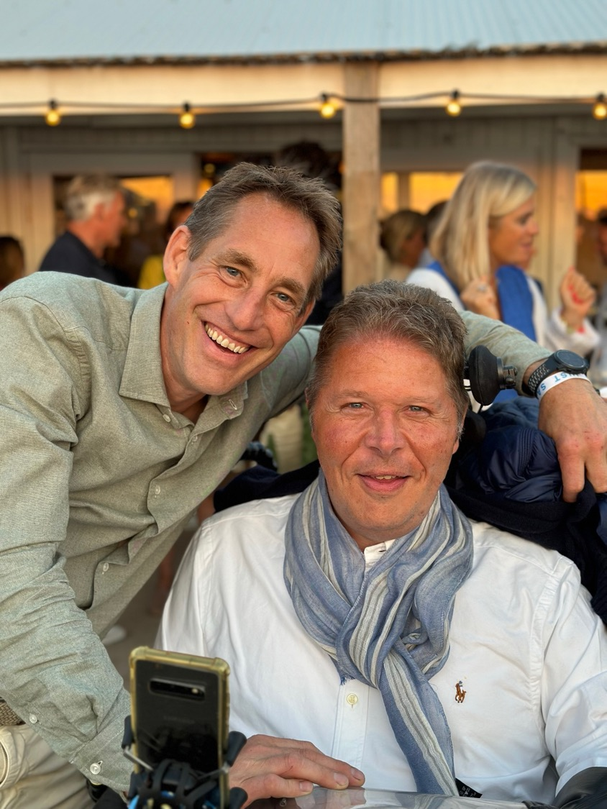
Fouders on a mission
Joost Bazelmans
46 yr, Entrepreneur & Innovator
Michiel Kin
47 yr, Accountant & Entrepreneur
We travel together for over 30 years. We have experience with travelling and spending holidays with a wheelchair. Michiel is in a wheelchair due to a progressive muscle disease.
Based on our experience and due to the lack of suitable campervans we decided to build a wheelchair accessible campervan.
We started Road Trip for Life Foundation to offer people in a wheelchair adapted transport to enable them to enjoy an adventurous vacation.

Slide 3

Freedom of movement
Mission
The foundation develops wheelchair accessible campervans with various care aids to facilitate the provision of care. The development of the camper is integrally documented, and all relevant information will be shared via our website. Thus, anyone who wants to build a wheelchair accessible campervan can make use of this information.
The foundation rents out the camper van for a low market fee. The foundation raises donations which are used for lowering the rental price, development and maintenance of the campers.
Vision
We believe that freedom of movement is essential for mental health. People traveling with a wheelchair often need to bring various care aids, a lot of hassle... For example, a lift is needed for making the transfer from wheelchair to toilet and bed.
By facilitating a campervan with the essential care aids on board we provide freedom of movement.

Slide 4
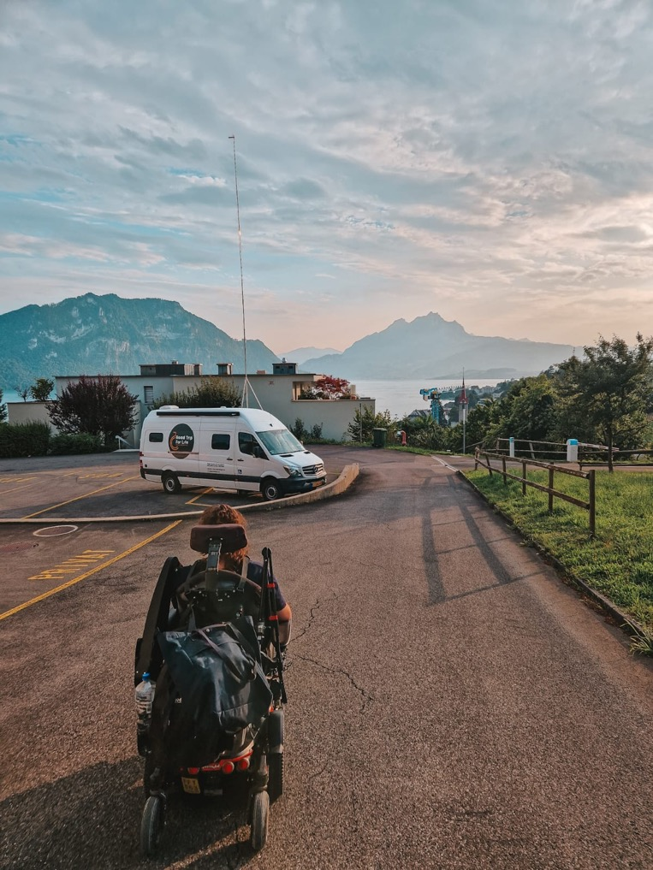

Adventurer Asmae
Visited Switzerland summer 2023

Slide 5
The market potential

Slide 6



The Challenge
17,4 mln
250.000
Only 3 wheelchair accessible campervans for rent in the Netherlands, and none found so far in Germany & Belgium
Making accessible adventures possible for all.

Slide 7
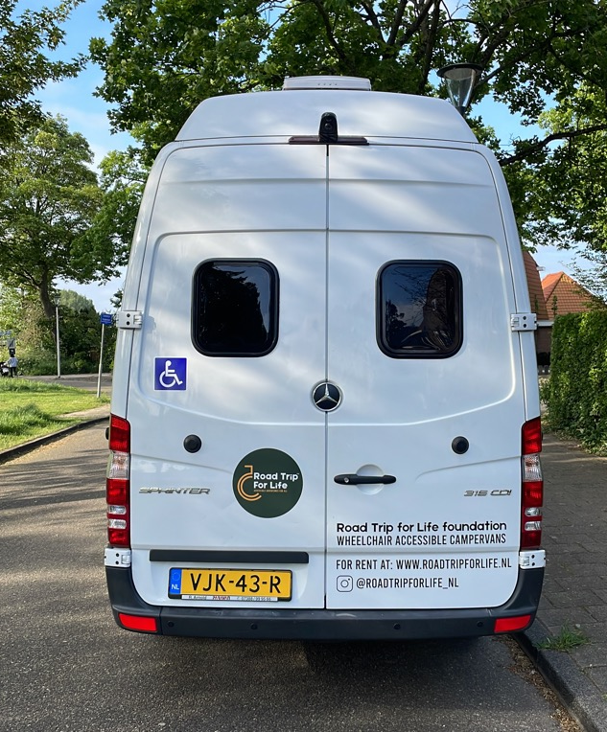
The Oppertunity
Investment campervan
160-180K
Weeks rented out 2023*
16 weeks
Prognosed in 2024**
24 weeks
Avg. revenue / week
€ 1.500,-
Avg. rental price / week
€ 900,-
Avg. mileage & additional service fees / week
€ 600,-
* Rental started 2nd week of May 2023.
** 13 weeks rented out (October ’23).
Making accessible adventures possible for all.

Slide 8
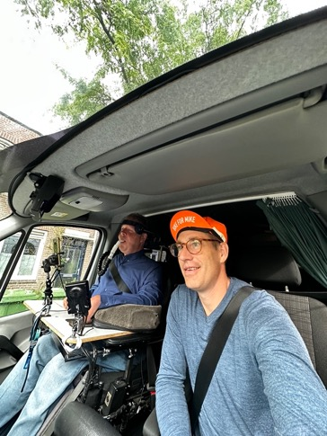
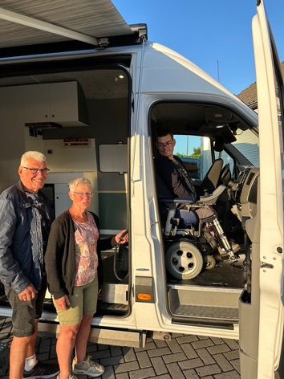
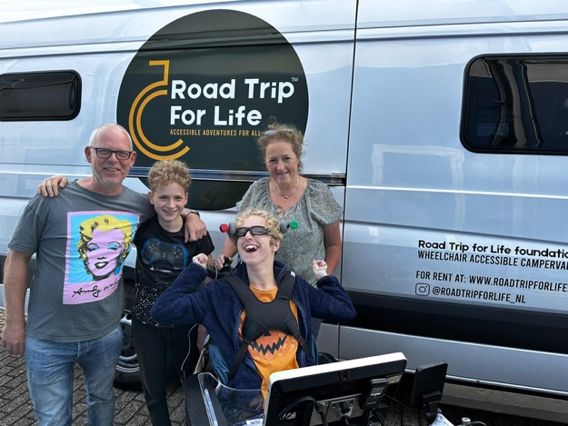
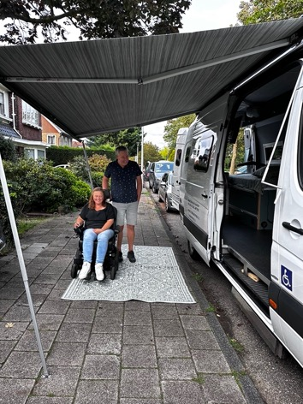
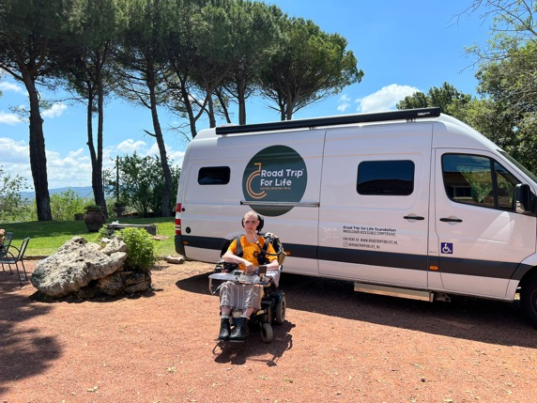
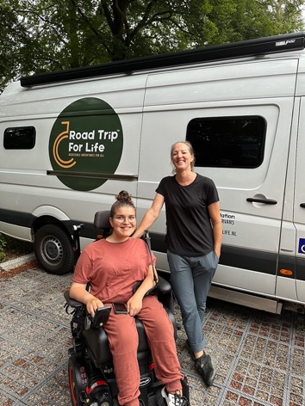
The van and it’s adventurers
Number of Bookings (q3-’23)
2023 => 16 weeks
2024 => 13 weeks booked
Happy campers, traveling without boundaries

Slide 9

Adventurer Sam
Visited Italy
summer 2023

Slide 10
Building a campervan

Slide 11
Our solution
Core Design requirements
Wheelchair in the front seat of the car
Ceiling hoist for a comfortable transfer from wheelchair to toilet and bed
Reliable power supply, also off grid
Adjustable bed, suitable for a standard sized medical anti-decubitus mattress
Focus on ergonomics for the care giver
Comply with camper requirements from national road traffic department
Can be driven with a regular driving license, total weight can not exceed 3.5 tons
Custom build with existing components

Slide 12
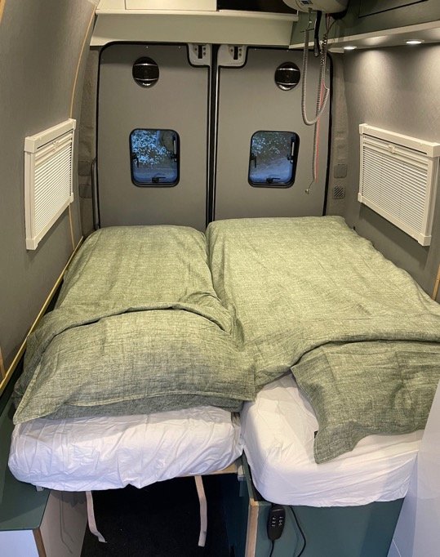
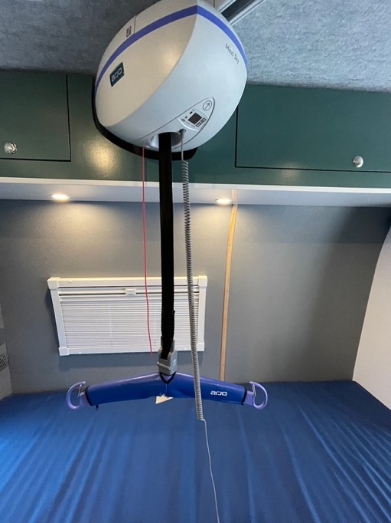
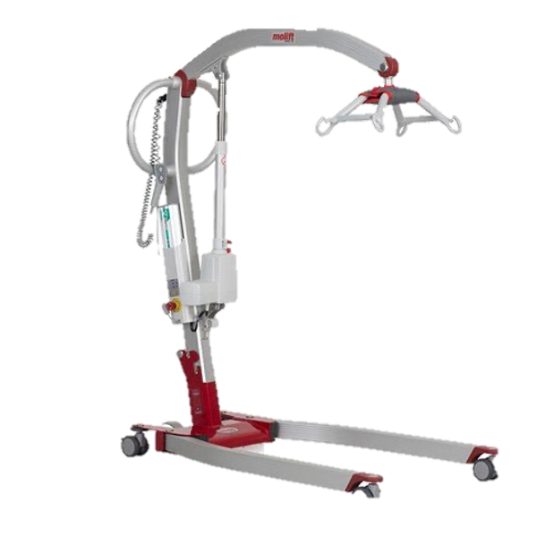
Care giving facilities on board
Electric adjustable bed
200x90cm
Ceiling hoist
Arjo Maxi Sky
Mobile crane lift
Molift
Designed and inspired by our personal experience

Slide 13
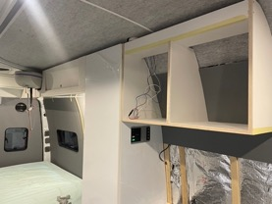
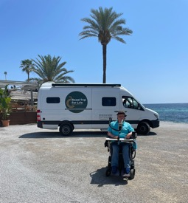
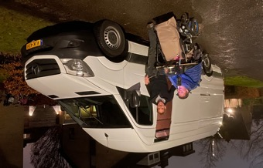
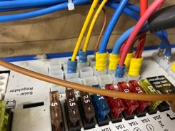
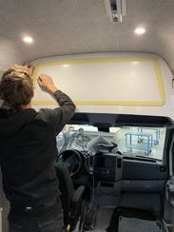
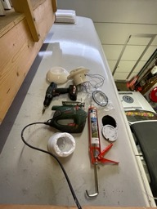
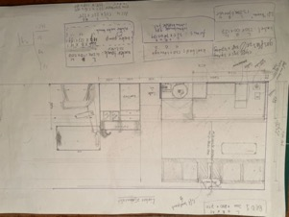
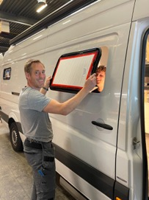
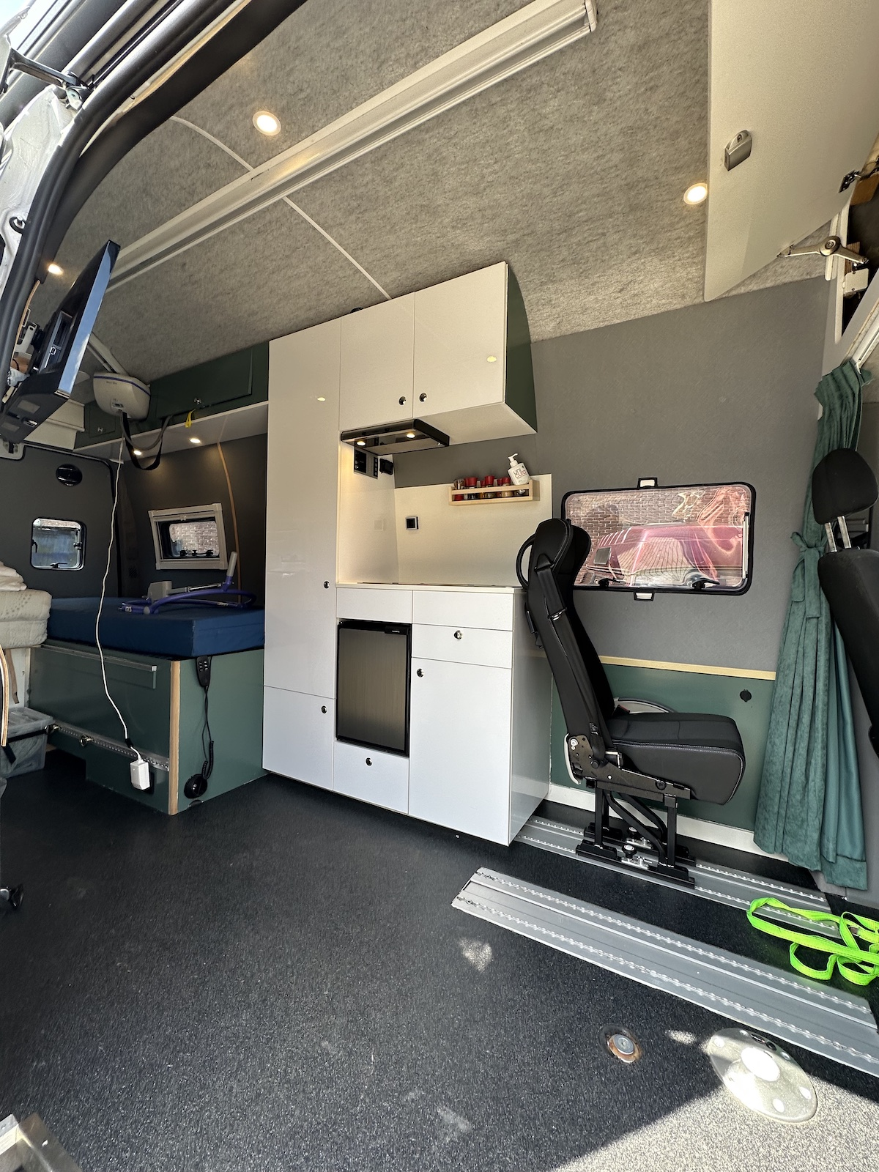
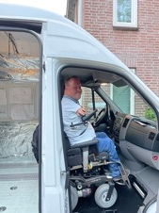
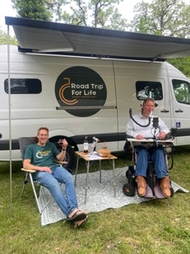
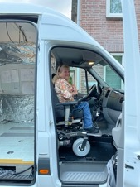
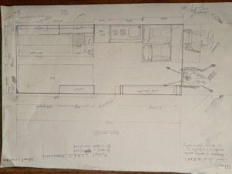
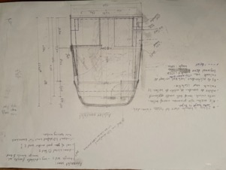
Development of prototype
Jan 2022
Apr 2022
Jul 2022
Oct 2022
Jan 2023
Mei 2023
Start rental

Slide 14
Build planning – next camper vans
Delivery time new Sprinter van
3 months
Chassis adjustment (front seat & suspension)
1 week
Cassette lift installation
1 week
Windows
1 week
Ceiling lift, rails
1 week
Planning based on experience building prototype
Electrical installation
1 week
5 months
Floorplate for additional seat & wheelchair tie down fixtures
1 week
Insulation, wall structure & flooring
2 week
Plumbing, water tanks, heater, gas bun, roof ventilation
2 week
Wall & ceiling coverings
1 week
Furniture; bed, kitchen & cupboards
3 week
Paint, table and details
2 week

Slide 15
Let’s have a look inside

Slide 16
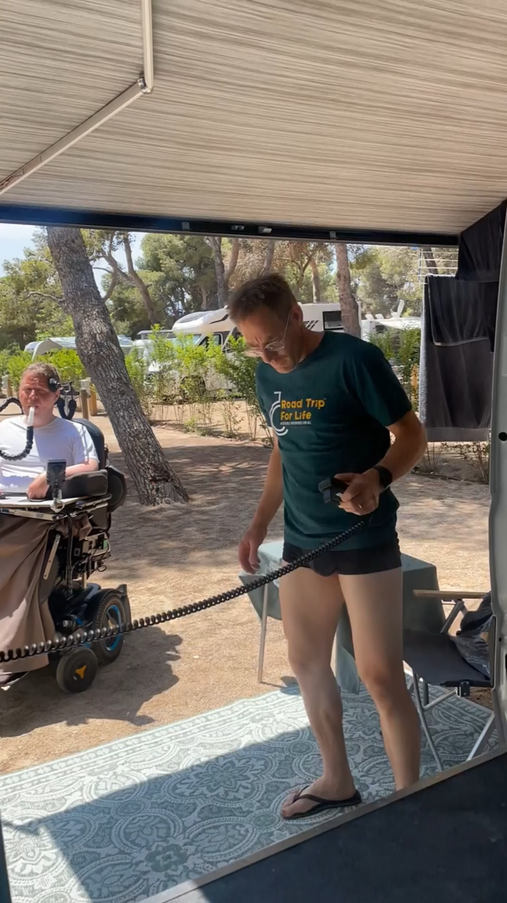

Click HERE see the full video on YoutubeClick HERE see the full video on Youtube
Click HERE see the full video on Youtube
Click HERE see the full video on Youtube
Click HERE see the full video on Youtube
Click HERE see the full video on Youtube
Click HERE see the full video on Youtube
Click HERE see the full video on Youtube
Click HERE see the full video on Youtube
Click HERE see the full video on Youtube
Click HERE see the full video on Youtube
Click HERE see the full video on Youtube
Click HERE see the full video on Youtube
Click HERE see the full video on Youtube
Click HERE see the full video on Youtube
Click HERE see the full video on Youtube
Click HERE see the full video on Youtube
Click HERE see the full video on Youtube
Click HERE see the full video on Youtube
Click HERE see the full video on Youtube
Click HERE see the full video on Youtube
Click HERE see the full video on Youtube
Transfer from Wheelchair to toilet to bed
Enter the campervan
Lift out of the wheelchair
Going to the toilet
To the bed
Getting dressed
Back into the wheelchair
Holiday!
Click HERE see the full video on Youtube
Adventurers Michiel & Joost
Visited Ibiza summer 2023

Slide 17
Phase two
Increasing the fleet of wheelchair accessible campervans

Slide 18
Growing the fleet
Three pillars
Development of 5 additional campervans based on the first prototype.
Create a rental marketplace for wheelchair accessible camper(van) owners.
Provide knowledge and components for self-build market, Open source.
Lead by example, scale together

Slide 19









Our friends & sponsors
Participating companies phase 2
Making accessible adventures possible for all.

Slide 20
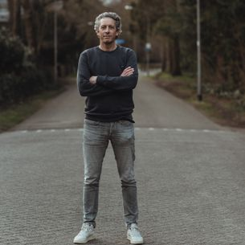
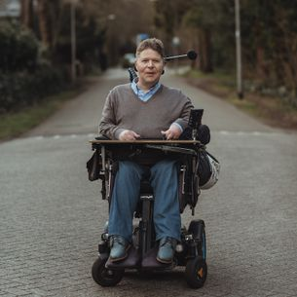
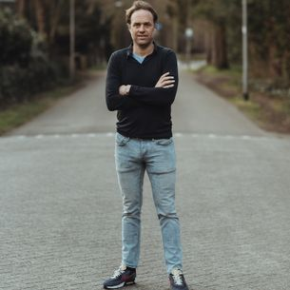
Working together
Board members foundation
Road Trip for Life Foundation is led by three board members. They perform their work unpaid.
Jochem Kin
MICHIEL Kin
LARS VAN MARRELO
Making accessible adventures possible for all.

Slide 21
Join our mission!
Not just in Holland,
but across the world.

